Slide 1

AML-2203 Advanced Python AI and ML Tools
Lambton College
School of Computer Studies
[Prepared By: Vahid Hadavi, PhD]

Slide 2
Lecture3 3. Evaluate vectors, matrices, and arrays in Python (Recommended Module: numpy)
Major Topics:
3.1 Use Python modules to work with vectors
3.2 Use Python modules to work with matrices
3.3 Use Python modules to interact with elements of matrices
3.4 Use Python modules to interact with elements of arrays
3.5 Use Python modules to reshape arrays

Slide 3
3.1 Use Python modules to work with vectors

Slide 4


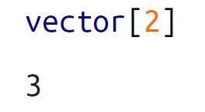
Vectors
We need to import numpy.
What is a vector? To create vector, we create one dimensional array.
Selecting element in vectors.
Use two different codes to call element ‘6’ from the vector above

Slide 5
3.2 Use Python modules to work with matrices

Slide 6
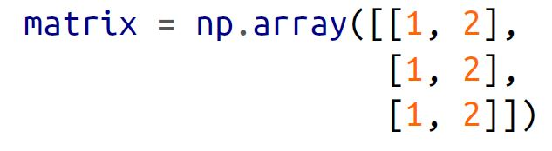
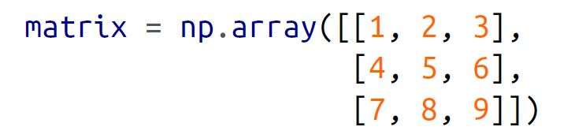
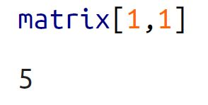
Matrices
We need to import numpy.
To create matrix, we create two-dimensional array (nested lists)
Selecting element in matrices.

Slide 7
3.3 Use Python modules to interact with elements of matrices

Slide 8
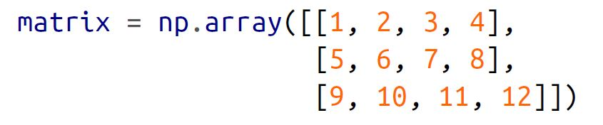
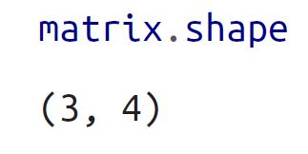
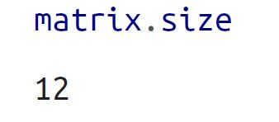
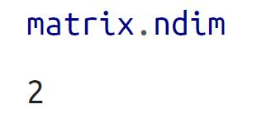
Describing a matrix
Describing the shape, size, and dimension of the matrix.
Dimension of a matrix, vector and scalar is 2,1 and 0, respectively.

Slide 9
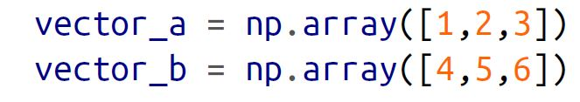
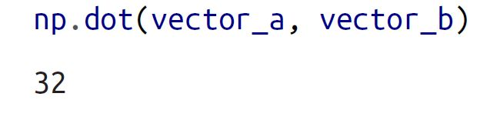
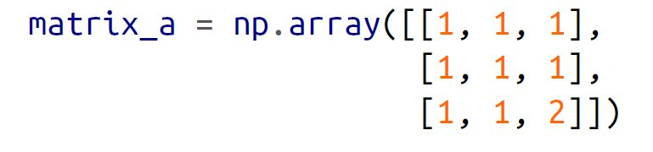
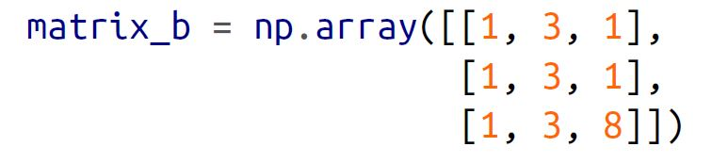
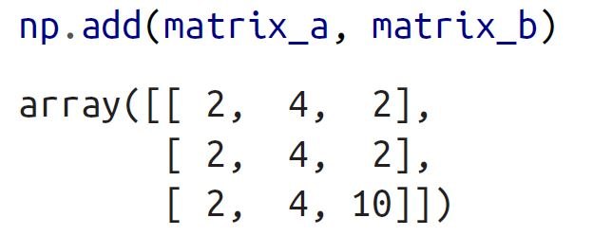
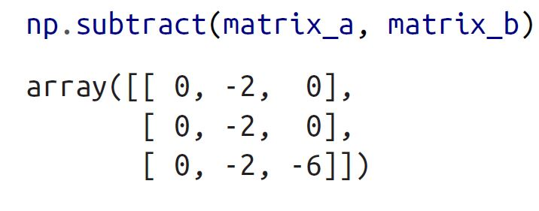
Dot product, adding and subtrng
Using dot method on numpy to calculate dot product.
Using add and subtract methods on numpy.

Slide 10
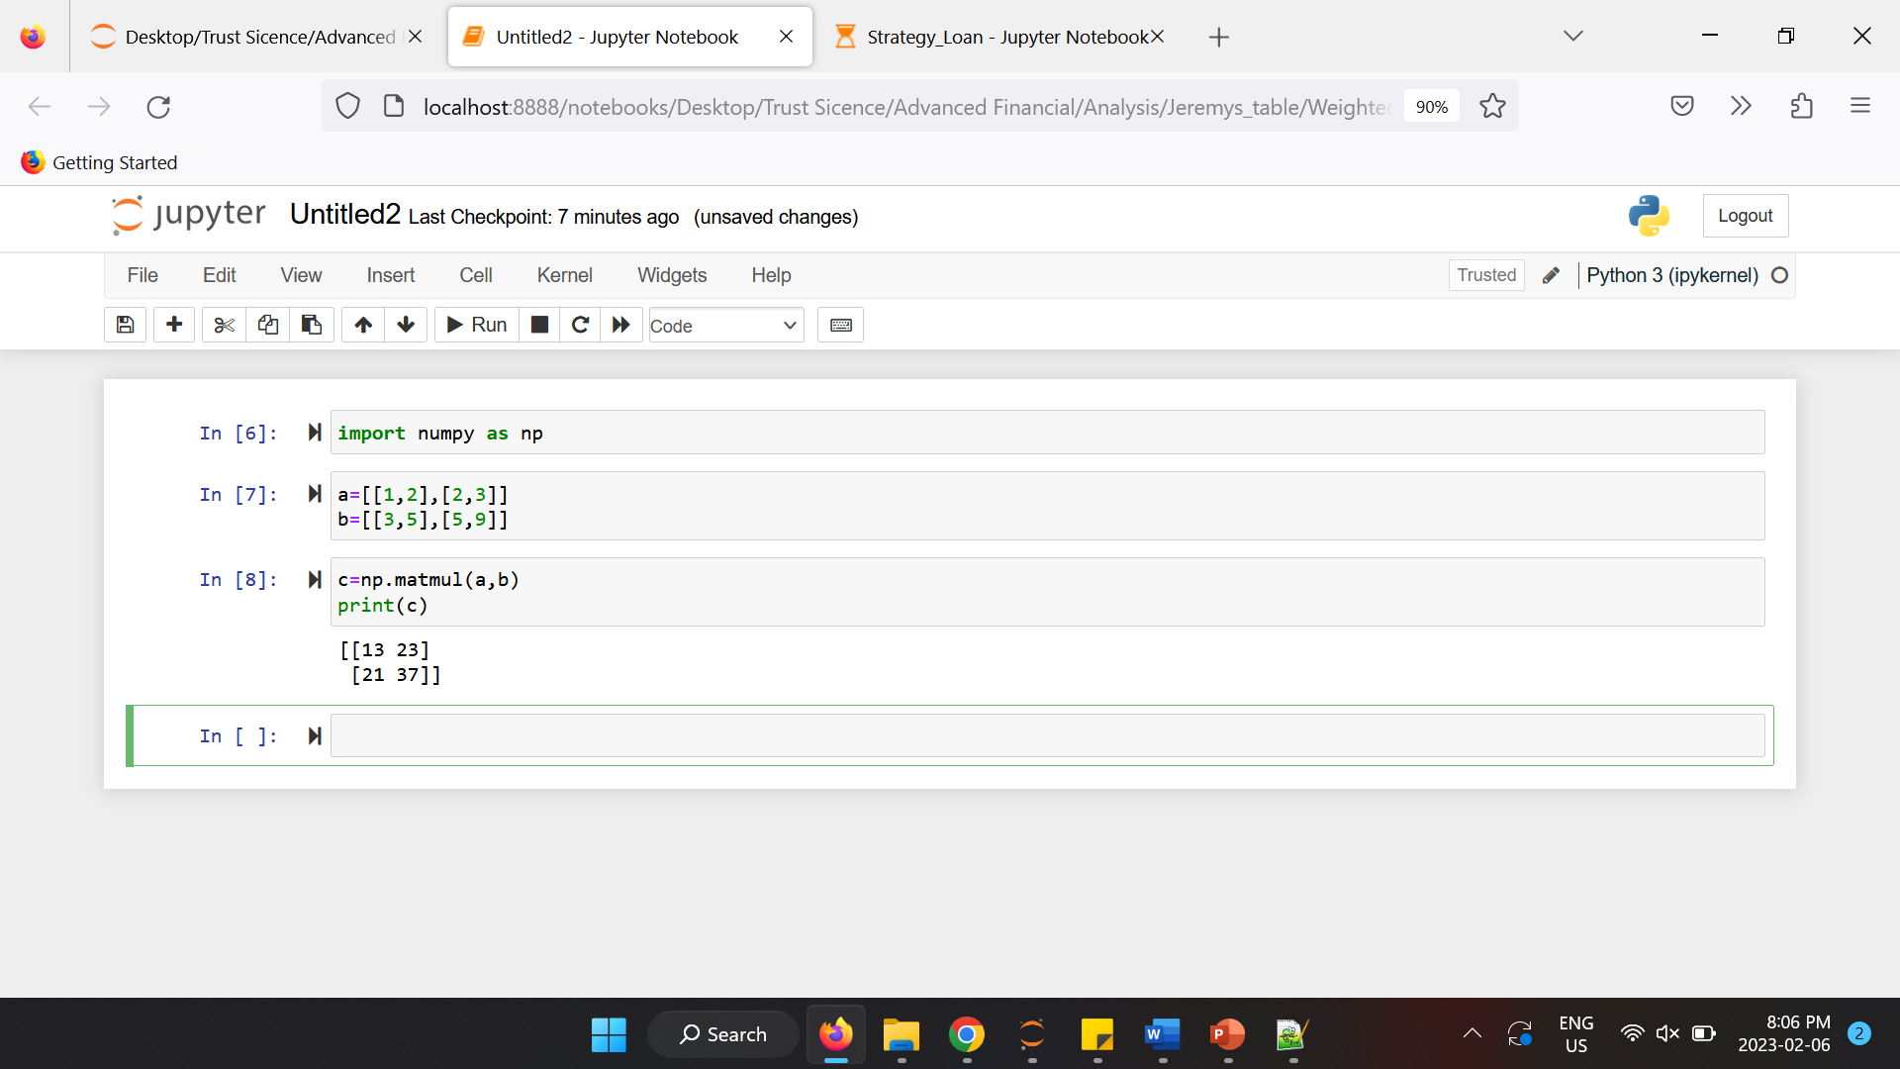
Matrix Multiplication
Challenge question : Write an algorithm that checks if two matrixes can be multiplied and if yes, develop a code without using any built in function to multiply two matrixes

Slide 11
3.4 Use Python modules to interact with elements of arrays

Slide 12
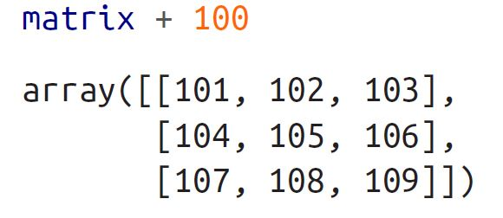
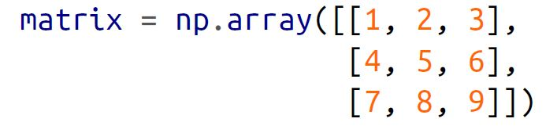
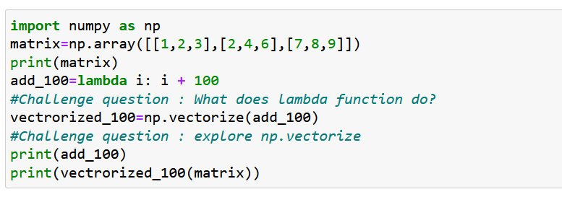
Applying Operations to Elements
Directly manipulating elements.
Using vectorize method to apply pre-defined functions.
np.vectorize : Define a vectorized function which takes a nested sequence of objects or numpy arrays as inputs and returns a single numpy array or a tuple of numpy arrays.

Slide 13
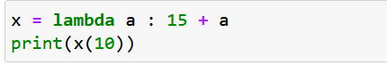
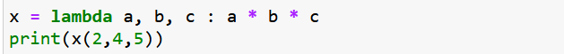
Python Lambda
A lambda function is a small anonymous function.
A lambda function can take any number of arguments, but can only have one expression
The expression is executed and the result is returned
Example : Add 15 to argument a and return the result
Multiply a,b,c arguments and return the result:

Slide 14
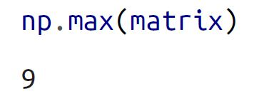
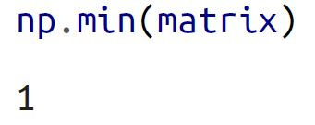
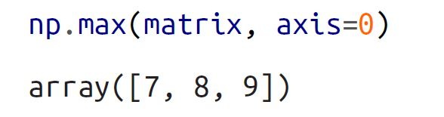
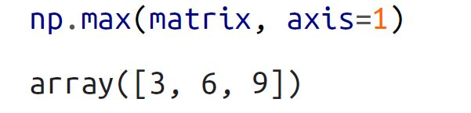
Finding Maximum and Minimum
Using max and min methods.
Using the axis parameter to apply the operation along a certain axis.

Slide 15
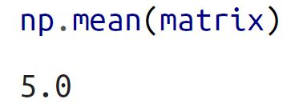
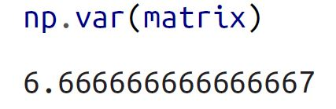
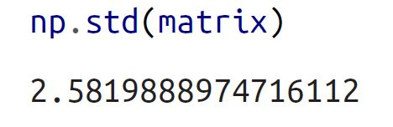
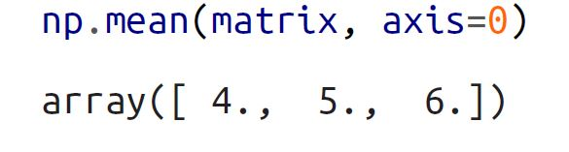
Calculating statistical values
Using mean, var and std methods on numpy.
Using the axis parameter to apply the operation along a certain axis.

Slide 16
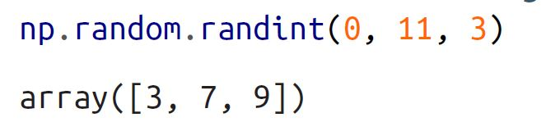
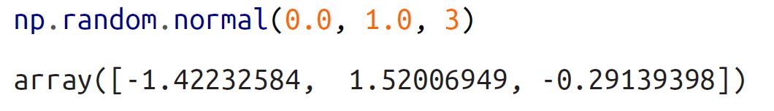
Generating random values
numPy offers a wide variety of means to generate random numbers.
Using randint on numpy to generate random integers in a certain range.
Using random.normal on numpy to draw numbers from a normal distribution with mean 0 and standard deviation of 1.

Slide 17
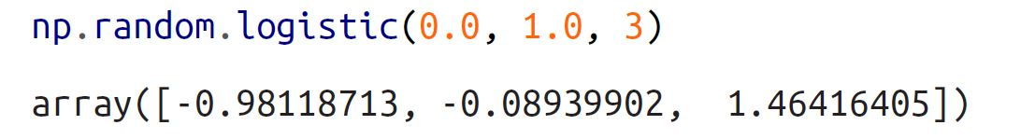
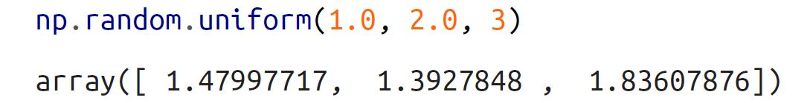

Generating random values
Using random.logistic on numpy to draw numbers from a logistic distribution with mean 0 and scale of 1.
Using random.uniform on numpy to draw numbers greater than or equal to a and less than b.
We set the seed value to have repeatable outputs from random methods.

Slide 18
3.5 Use Python modules to reshape arrays

Slide 19
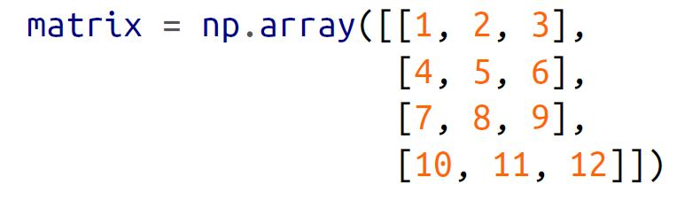
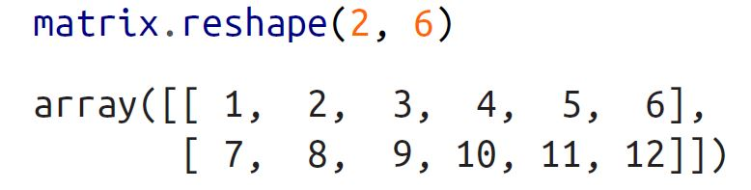
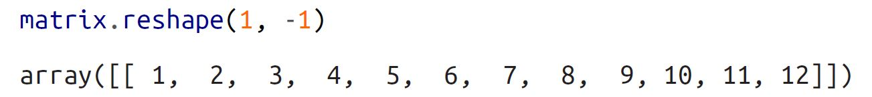
Reshaping arrays
Using reshape method on numpy.
Size of the array before and after reshaping must match
One useful argument in reshape is -1, which effectively means “as many as needed,”.

Slide 20
Any questions so far? Any comments?

